Slide 1

Overview of Azure Stack Hub
What is Azure Stack Hub?
This work is licensed under a Creative Commons Attribution - ShareAlike 4.0 International Public License

Slide 2
Agenda
Cloud transformation
Overview of Azure Stack Hub
Hybrid use cases
Azure Stack Hub integrated systems

Slide 3

Microsoft Azure
Hybrid
Productive
Intelligent
Trusted

Slide 4
Hybrid cloud presents great opportunity
74%
58%
6x
Enterprises believe a hybrid cloud will enable business growth
Enterprises have a hybrid cloud strategy, up from 55 percent a year ago
Growth of IT spending on public cloud services is 6x of overall IT market
45% of organizations will use service providers
Sources: 1) Avanade Global Study: Hybrid Cloud–From Hype to Reality, 2) RIghtScale 2017 state of the cloud report, 3) IDC Worldwide Semiannual Public Cloud Services Spending Guide 4) tier 451 research

Slide 5

Azure Stack Hub promise
Consistent
application development
Azure services
available on-premises
Integrated
delivery experience

Slide 6

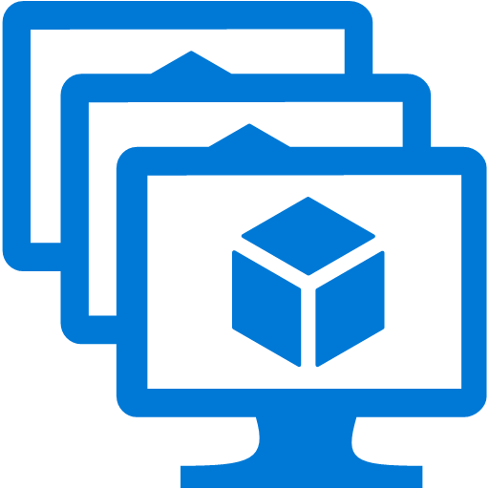
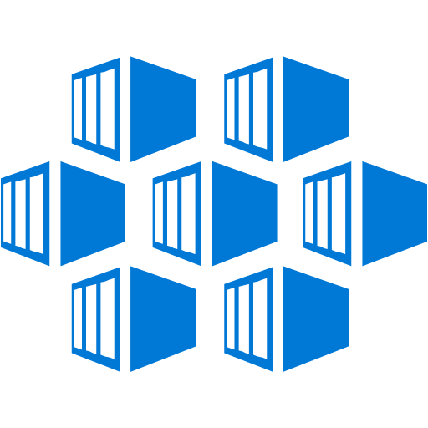


Azure Capabilities on Azure Stack Hub
Virtual
machines (VM),
VM scale sets
Containers
Networking
Storage
Key Vault
Azure App Service
Azure Functions
Azure Marketplace
Rapid deployment with scaling on demand
Linux and Windows Server containers
Virtual network, load balancer,VPN gateway
Blobs, tables, queues
Securely protect application keys and secrets
Web and API apps
Serverless Computing
Ready to go Apps from the Azure Marketplace

Slide 7

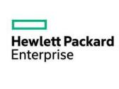










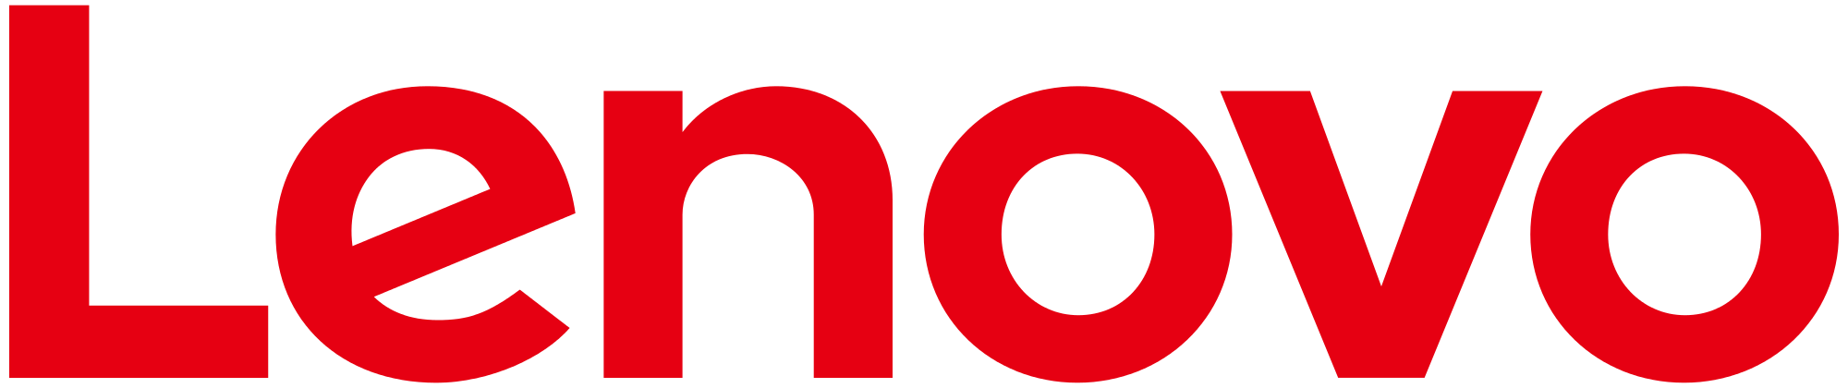









Ecosystem
Integrated systems
Azure Marketplace

Slide 8
Integrated delivery experience
Integrated systems
Fast to deploy
Pay-as-you-use
Integrated support, broadly available
Multiple solutions partners available (see next slide)
Get up and running quickly
Deliver 100s of VMs initially (and grow over time)
Extension of Azure model
Receive one bill
Consistent support experience, no matter who you call
Available in 46 geos initially

Slide 9
Microsoft Azure: Only consistent hybrid cloud
Azure Active Directory
Azure management and security
Azure
data services
Azure services
Clouds
Common Identity
Integrated Management and Security
Consistent Data Platform
Unified Development and DevOps
Active
Directory
On-premises
infrastructure
SQL Server
Azure Stack Hub

Slide 10

Azure Stack Hub is an extension of Azure Only consistent hybrid cloud platform
Azure
Consistency
Azure Stack Hub

Slide 11
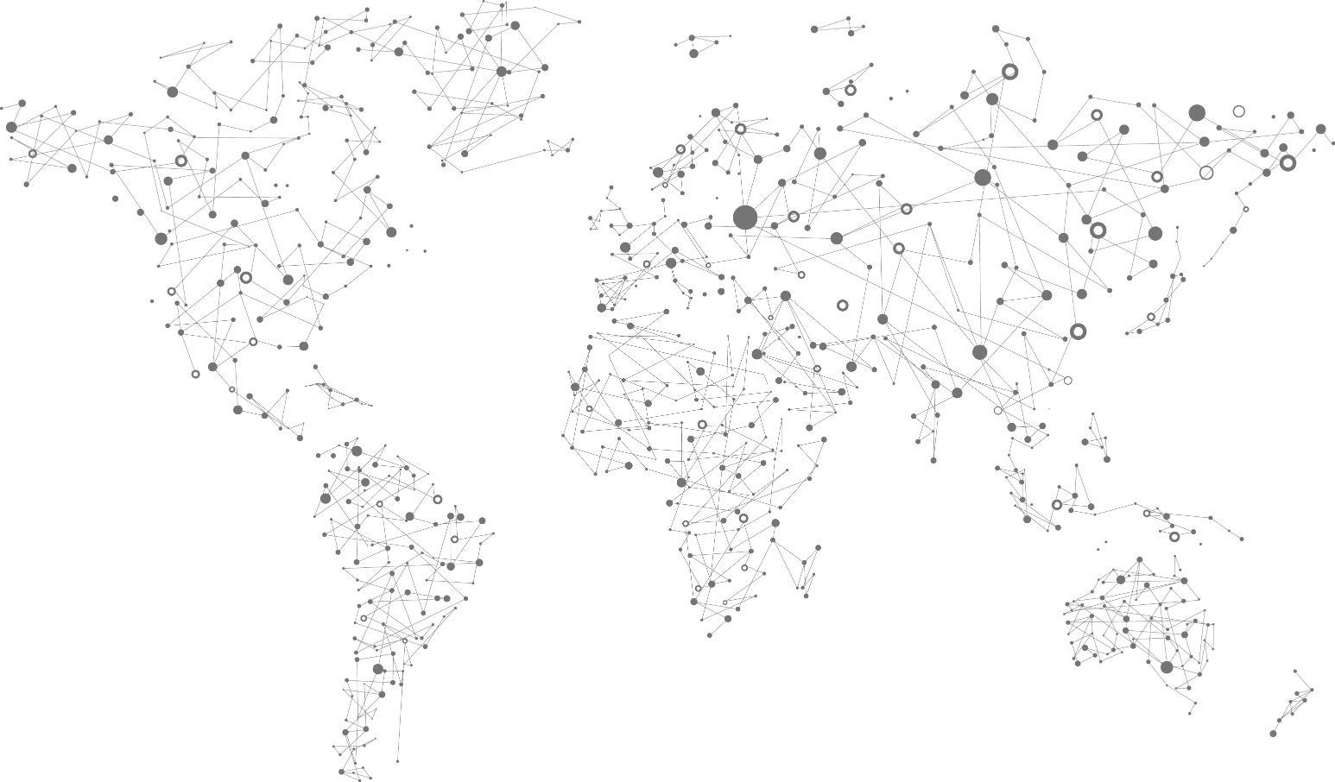
Azure services everywhere
54 Azure regions
100s of service providers
1,000s of enterprises

Slide 12

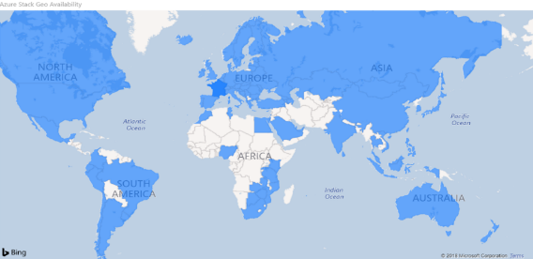

Latest: Azure Stack Hub now in 92 countries
Microsoft Azure Stack Hub strengthens our mission while also enabling us to deliver value to a new set of customers and partners in some of the most remote parts of Africa”

Slide 13
Customers Ask:
Why Azure Stack Hub
What to Move to Cloud vs. Keep on Azure Stack Hub
Take Me to Cloud
Keep Me on
Cloud and Azure Stack Hub
PARTNERS
Advise
Business and IT Value
Digital Transformation
Assessment
Infrastructure, Data, Apps
Migrate
Train, Migrate, Deploy
Optimize
Support , Managed Services and New Solutions

Slide 14




Partners providing value to customers Customer scenarios and solutions
15x – 20x
SaaS
ISV App
Managed SaaS
Applications
Partner Opportunity
Resell Azure / Operate Azure Stack Hub
Managed Azure
Infrastructure
Services Attach
<1x
2x – 5x
5x – 15x

Slide 15

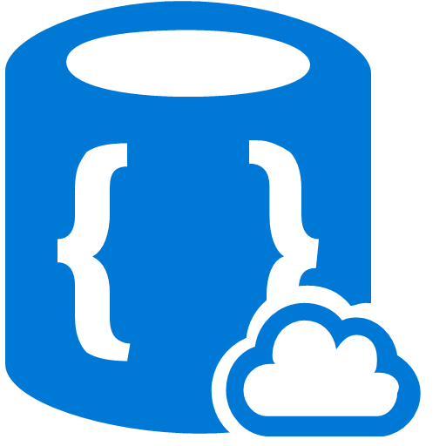


Use Azure Stack Hub for:
Real-time latency requirements
Connectivity issues
Local data processing
Use Azure for aggregate analytics and big data modelling
Common application logic across both, connected, or disconnected
Aggregated analysis
Data collection
Local data processing
Azure Stack
Azure Stack
Azure Stack
Limited or no connectivity
Edge and disconnected solutions

Slide 16

Develop and deploy global application in Azure
Optionally deploy to Azure Stack Hub to handle customer preferences for regulations:
Government
Industry
Region
No changes to application
Azure
Country #1
App
Country #2
Country #3
Cloud applications to meet varied regulations

Slide 17

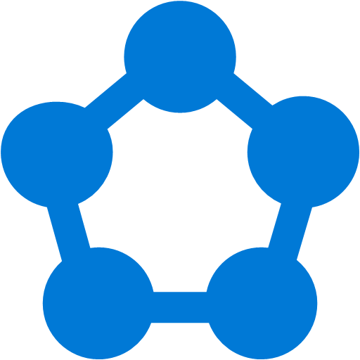

Apply modern architectures to on-premises apps not yet ready for cloud
PaaS
Serverless computing
Microservices and containers
Move to Azure without code changes
Consistent programming model, skills, and processes
Azure services
Existing app
Cloud application model on-premises

Slide 18
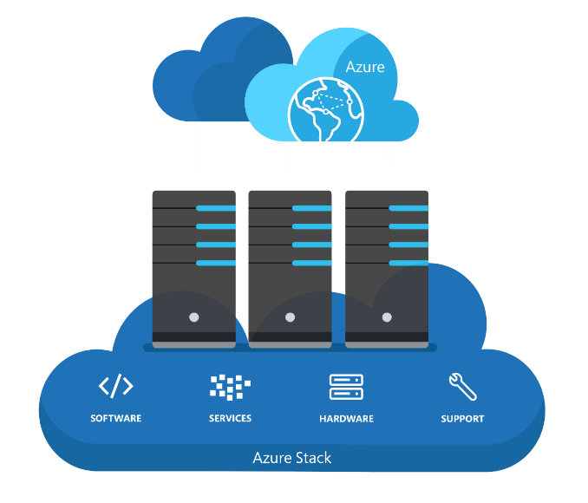
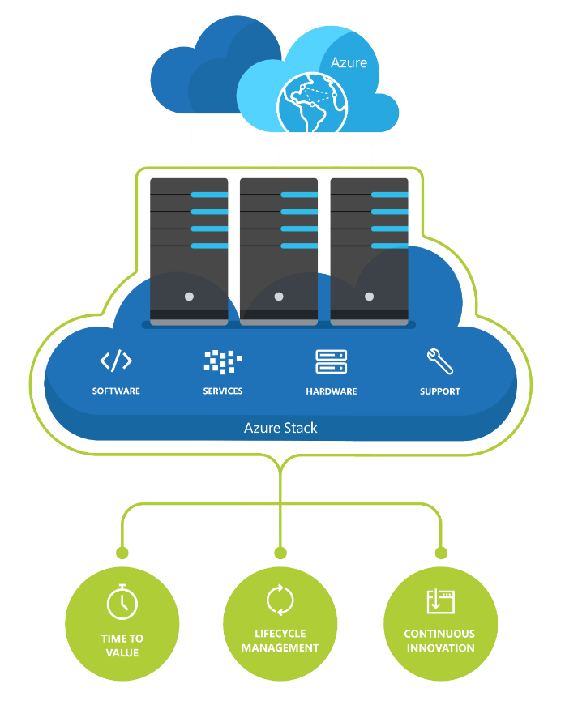



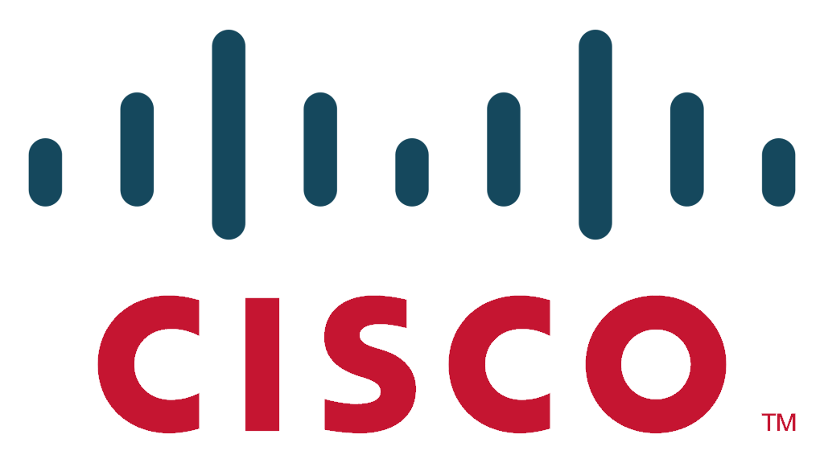

Appliance-like integrated systems deliver Azure-consistent innovation with tightly-controlled and thoroughly-tested hardware/firmware/software combinations for the best reliability and availability.
Purpose-built systems
for operational excellence
.….
...
...
Over time, we will add additional partners and hardware configurations.

Slide 19


Integrated support experience
Consistent support experience no matter who you contact for support
Coordinated escalation and resolution process – the same ticket can be passed between Microsoft and the OEMs
Cloud services support delivered by Microsoft
System support delivered by hardware partners
For CSPs running Azure Stack Hub, the end user contacts the CSP first, and then the CSP may contact Microsoft or OEM
Microsoft frontline support
Coordinated escalation and resolution process
Customer calls either vendor
Hardware partner frontline support

Slide 20



Integrated delivery experience
Focus on value-added services (vs. infrastructure)
Integrated systems
Fast to deploy
Easy to grow
Pay-as-you-use
End-to-end support
Deploy quickly
Deliver 100s of VMs initially (and grow over time)
Extension of Azure model
Receive one bill
Get consistent support, no matter who you call

Slide 21


Managed Services opportunities
Depth of Azure Expertise
Dev-Ops & Automation
Operations & Optimization
Business capabilities:
Data Insights – IoT, ML, Cognitive Services
Enable mobile workforce
Technical capabilities:
Cloud Architecture & Design
Migration, Management, Optimization
Security & Compliance
Automation & analytics, Standardization
Template based approach for operational best practices
Roles & process focus for continuous delivery, SysOps
Governance, Reporting, Financial Management & Audits
Custom financial models
Continuous cost optimization
Custom SLAs and contract terms

Slide 22
In Development | Azure Stack Hub
Azure Container Service (AKS) on Azure Stack Hub
Managed Disks in Azure Stack Hub
Expanded support for VPN Gateway interoperability
IoT Hub
Azure capabilities on Azure Stack Hub
Now available | Azure Stack Hub
Service Fabric on Windows Server and Linux
Support for Containers on Windows Server and Linux
Azure Storage API version 2017-04-17
Azure Stack Hub infrastructure capabilities
Av2 and F VM size families in Azure Stack Hub
Now In Preview | Azure Stack Hub
Support for templated Kubernetes deployments
Support for templated Service Fabric cluster deployments
Roadmap

Slide 23
In Development | Azure Stack Hub
Azure Stack Hub integrated systems with 16 node scale units
Ability to incrementally add capacity to Azure Stack Hub
Azure Stack Hub integrated systems support for multiple scale units
Azure Stack Hub security - Drift Detection
Azure Stack Hub support for ASR
Azure Stack Hub support for Azure Backup
Azure Stack Hub infrastructure backup and cloud recovery
Azure Stack Hub operator experience feature updates
Display VM prices in Azure Stack Hub portal
Azure Government Cloud Integration for Azure Stack Hub
Azure capabilities on Azure Stack Hub
Azure Stack Hub infrastructure capabilities
Now available | Azure Stack Hub
Compliance certification guidance
Azure China Cloud support for Azure Stack Hub
Azure backup support for tenant workloads
Azure Stack Hub infrastructure backup and cloud recovery
Roadmap

Slide 24
Summary: Accurately positioning Azure Stack Hub
What it is
What it isn’t
First consistent Hybrid Cloud Platform
Virtualization-replacement play
Integrated system with IaaS and PaaS
DIY infrastructure
Regularly updated for Azure-consistency
Static system you deploy and forget
Truly open and flexible (just like Azure)
.NET/Windows only

Slide 25
Get going with Azure Stack Hub
Start your journey to be a certified Azure Stack Hub operator today
DEVELOP
VALIDATE
DEPLOY
1
2
3
Develop applications in Azure
Download Azure Stack Hub Development Kit
Order Azure Stack Hub integrated systems for production deployment

Slide 26
Questions?

Slide 28
Appendix

Slide 29
Cloud Service Provider (CSP)

Slide 30
Your business opportunity with Azure and Azure Stack Hub
Cloud
CSP on Azure and Azure Stack Hub
Dedicated and multi-tenant Azure Stack Hub offers
On-premises

Slide 31
CSP – Enabling partner success
Differentiate, deepen customer relationships
Build recurring revenue
Higher margins
Unlock portfolio opportunities
Training resources

